Slide 1

Black Friday Sales PREDICTION

Slide 2
The dataset comprises of sales transactions captured at a retail store. It’s a classic dataset to explore and expand our feature engineering skills and day to day understanding from multiple shopping experiences. This is a regression problem. The dataset has 537,577 rows and 12 columns.
This project analyzes the Black Friday sales data and tries to answer these key business questions :
What are maximum products sold?
Which Product category has highest sales?
Finding the buyer's age group and their product of interest.
Finding the marital status of the buyers.
Analyzing the gender group, which has high interest in the sales
This can be used to understand the customer purchase behaviour (specifically, purchase amount) against various features like Products of different Categories, Gender, Age, Occupation of Customer, etc.
This project also aims at creating a simple predicting model to predict the purchase amount of customer against various products which will help them to create personalized offer for customers against different products.

Slide 3
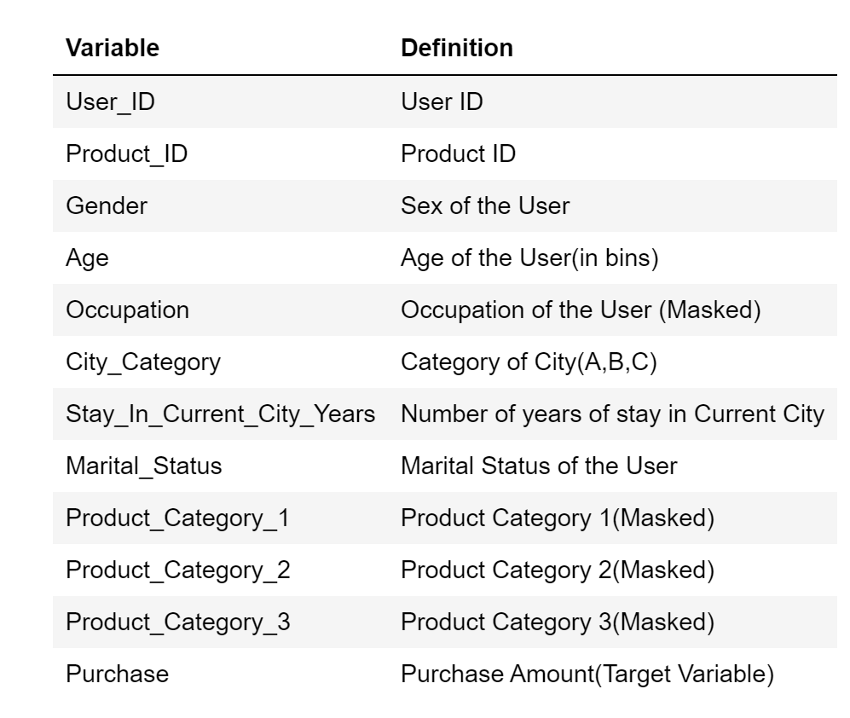

Slide 4
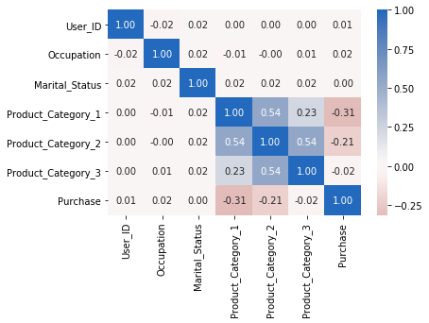
Correlation Plot From the plot, we can see that, the correlation between Product Category_1, Product Category_2 and Product Category_3 is greater than 0.5 which means these variables are moderately correlated.

Slide 5
Addressing the Null/NA values
There were 166986 null values in Product_Categorgy_2 and 373299 null values in Product_Category_3.
The proportion of missing values in the dataset were upto 70%.
Removing the NaN values will result in 70% loss of data from the data set. This results in the model being biased and it would be underfit.The available alternate approaches are replacing the missing values with mean, mode or fill it with 0.
The values in Product_Catgeory_2 and Product_Catgeory_3 coulmns are interlinked with values present in Product_Catgeory_1, hence replacing it with mean/mode is not a good strategy.
Thus, I decided to fill the Nan values with 0.

Slide 6
Exploratory Data Analysis
The nunique() method gives us the uniques values present in the column.
From the User_ID, we can conclude that in this specific retail store, during Black Friday, 5,891 different customers have bought something from the store.
Also, from the Product_ID, we can see that there are 3,623 different products that have been sold.

Slide 7
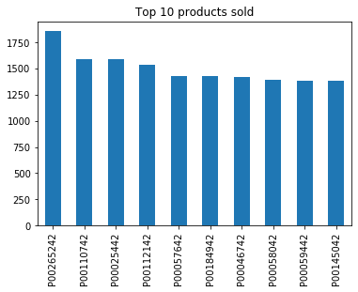
We can see from the graph that, the top 10 products are sold more than 1200 in quantity. The description of the products, is however not present in the dataset. But let us see what all product category that interested the people.
Most Purchased Products :

Slide 8
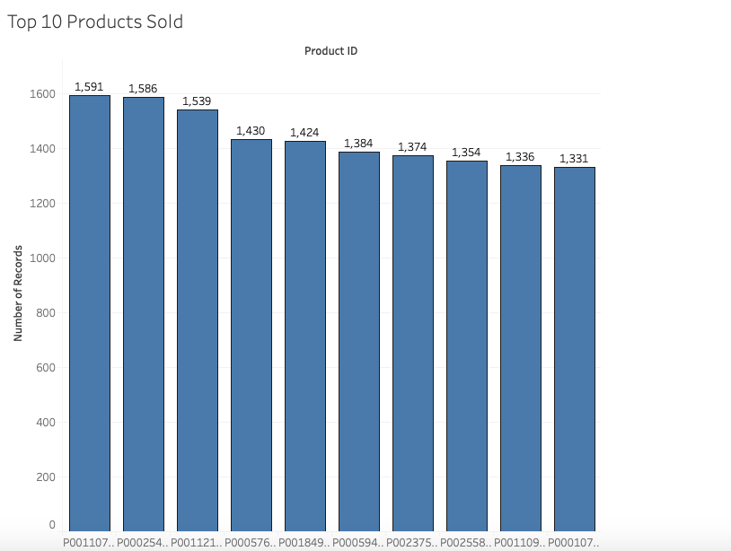

Slide 9
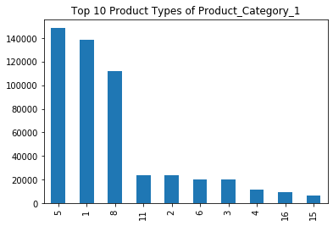
Maximum sold Product Category : Product Category 1
The highest selling product types of Product_Category_1 are 5,1, and 8 which are worth more than 100k.

Slide 10
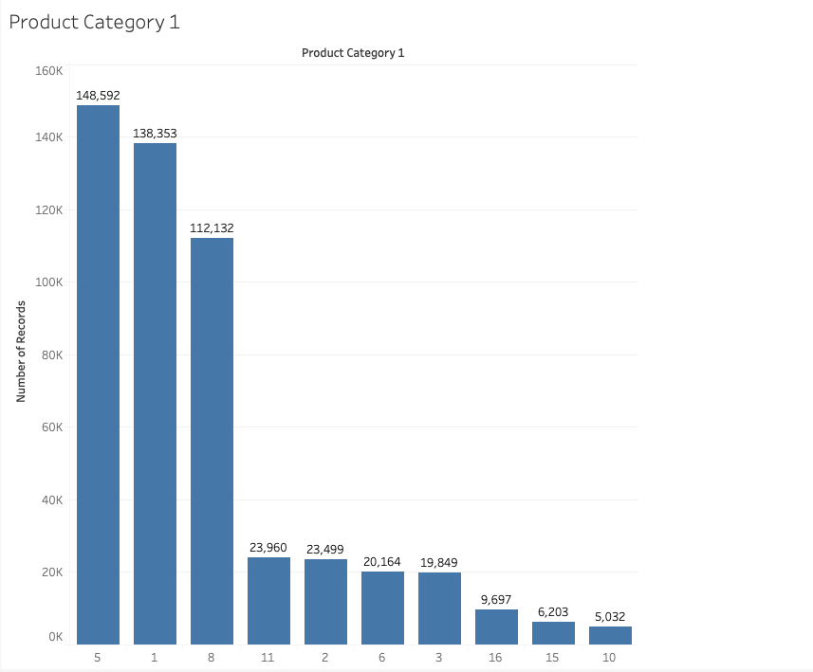

Slide 11
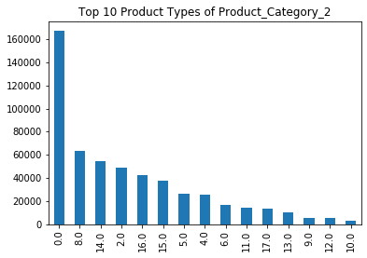
Maximum sold Product Category : Product Category 2
The highest selling product types of Product_Category_2 is 0, which is worth upto 160k. Product types 7, 13 and 1 have sold upto 50k.

Slide 12
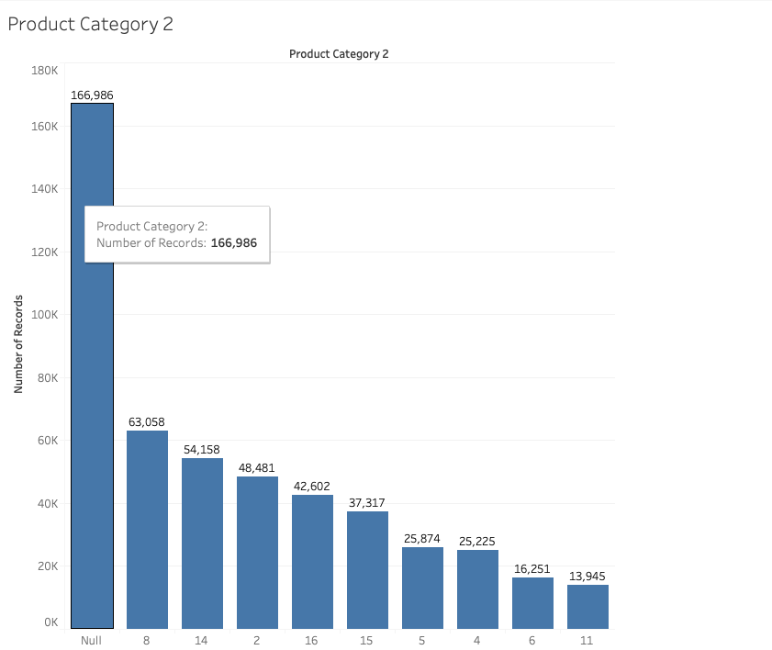

Slide 13
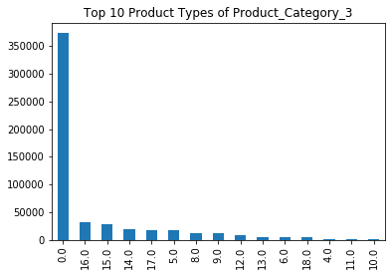
Maximum sold Product Category : Product Category 3
The highest selling product types of Product_Category_3 is 0, which is worth upto 3500k. Product types 13, 12 and 11 have sold upto 40k.

Slide 14
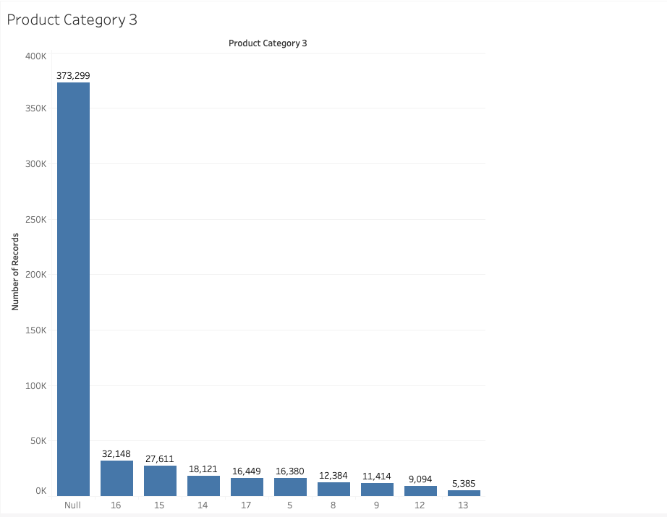

Slide 15
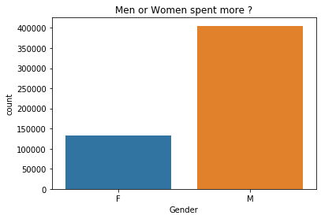
Men or Women, who are likely to spend more?
From this, we can see that the number of male customers is almost 3 times higher than the number of female customers. This could mean that, Men are most likely to buy during the Black Friday sales.

Slide 16
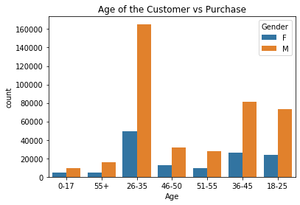
Age of the Customers :
From the graph, we see that the Majority of customers are from the age group of 26-35. We can also check the majority of a gender among the age groups by adding a hue. And as seen above, more Men spent in the sale than Women.

Slide 17
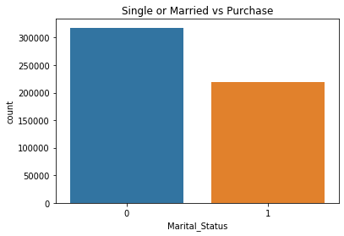
Married or Individuals, who spends more?
From the above graph, we can see that, Single customers purchased more than Married Customers.

Slide 18
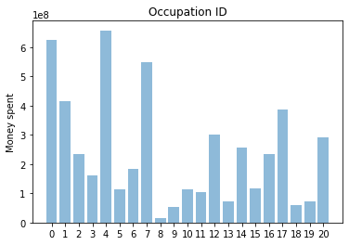
Occupation of the Customers :
The Occupation number could represent different professions of customers: for example, number 1 could be an engineer, number 2 a doctor, number 3 an artist, etc.
It can be easily observed that people with Occupation IDs 0 and 4 spent the most money during Black Friday sales.
On the other hand, the people with Occupation IDs 8, 9, and 18 have spent the least amount of money.
It can imply that these groups are the poorest ones, or contrary, the richest people who don't like to shop in that kind of retail stores. We have a deficiency with information to answer that question, and because of that, we would stop here with the analysis of the Occupation category.

Slide 19
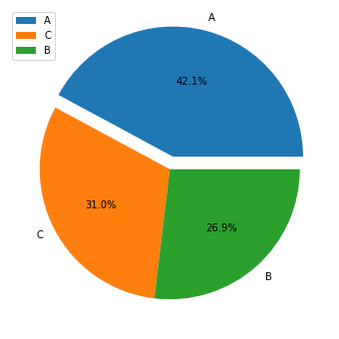
City Category :
It is evident from the pie chart that all the three cities are almost equally represented in the retail store during Black Fridays. Maybe the store is somewhere in between these three cities, is easily accessible and has good road connections from these cities.

Slide 20
Data Pre-processing :
User_ID is is the number assigned automatically to each customer, and it is not useful for prediction purposes.
The Product_ID column contains information about the product purchased. It is not a feature of the customer. Therefore, we will remove that too.
The data type of all the variables are different. We will convert all the variables to int to perform Linear Regression.

Slide 21
Multiple Linear Regression :
Linear regression represents a very simple method for supervised learning and it is an effective tool for predicting quantitative responses.
We have performed Multiple Linear Regression using the OLS (Ordinary Least Squares) Model.

Slide 22
#Coefficients of the variables
result.params
Gender 2918.355372
Age 764.406935
Occupation 83.852379
City_Category 1249.388544
Stay_In_Current_City_Years 677.098363
Marital_Status 375.153063
Product_Category_1 -72.616341
Product_Category_2 101.864735
Product_Category_3 302.279087
dtype: float64

Slide 23
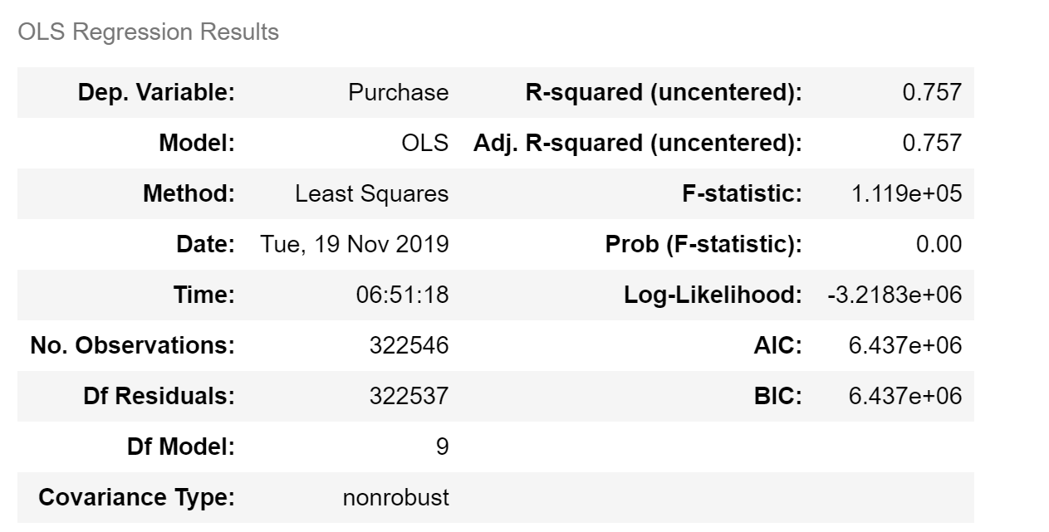
Summary of Linear Regression model :

Slide 24
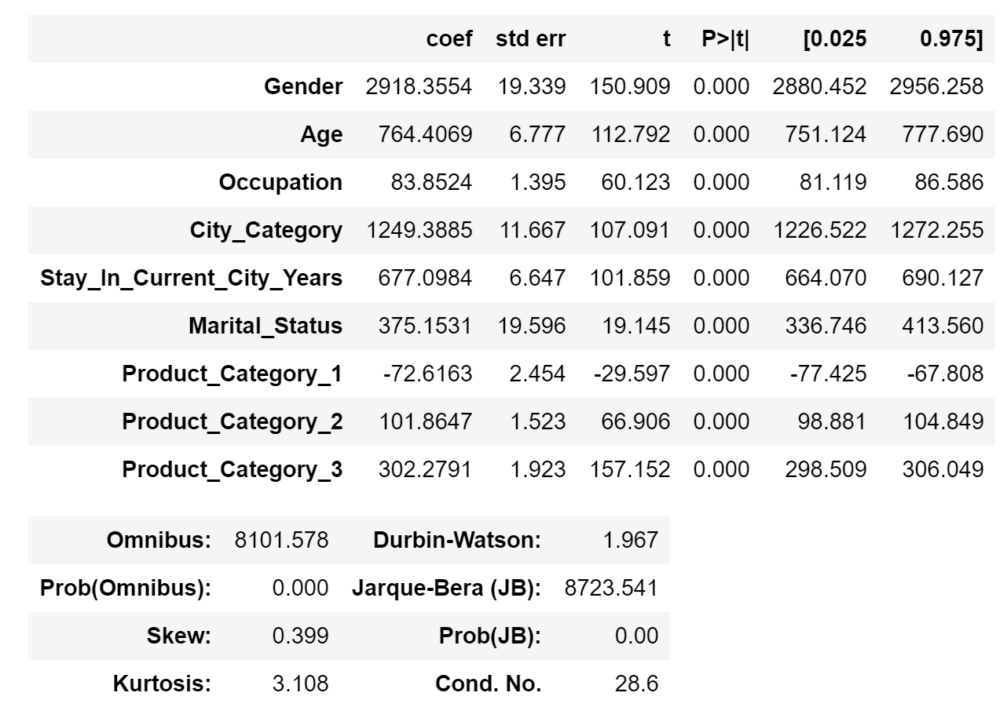

Slide 25
Performance Estimation of the model :
In the end, it is always good to estimate our results by finding the mean absolute error (MAE) and mean squared error (MSE) of our predictions.
MAE: 4071.004455731231
MSE: 27179739.770752437

Slide 26
Conclusion for Multiple Linear Regression :
p-value ≤ 0.05 indicates strong evidence against the null hypothesis, so you reject the null hypothesis.
All variables except the Product_Category_1 are positively associated with Sales.
R-squared score is 0.757, which means that this model explains 75% of the total variance.
Hence, the proposed model is a good model.

Slide 27
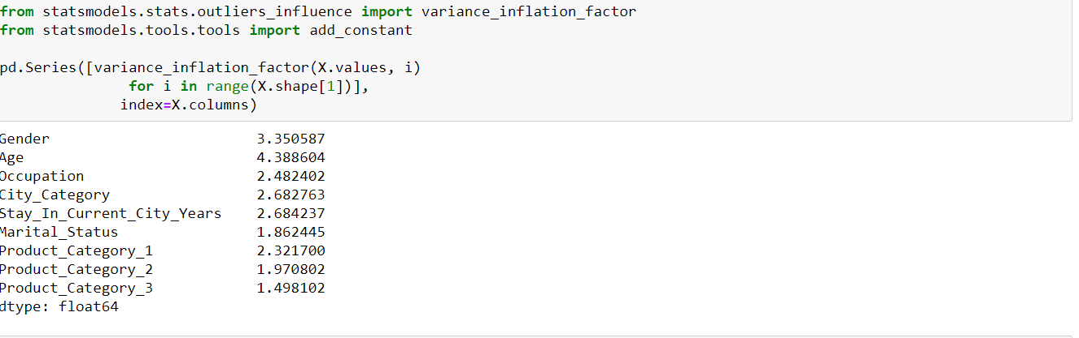
Collinearity and Regularization
What if the independent variables are not independent of each other i.e. collinearity or multicollinearity is present among the predictor variables. We check the same using VIF( Variance inflation factor).

Slide 28
Collinearity and Regularization
We can see from the VIF check that there is no collinearity among the dependent variables which is in a severe range except Age and Gender column, but it is not severe.
When predictor variables are related, they fit well into a straight regression line that passes through many data points
It is difficult to ascertain reliable estimates of each coefficients for the predictor variables which results in incorrect conclusions
In these cases stated above Lasso, Ridge and Elastic Net Regression comes into play to combat variance problems

Slide 29
Ridge Regression
Ridge Regression: It helps reduce Variance by shrinking parameters and making predictions less sensitive. It can find solution with Cross validation and Ridge Regression Penalty. Better when all variables are useful. Since in our variables, we could see that all the variables are important hence we use Ridge for regularization.

Slide 30
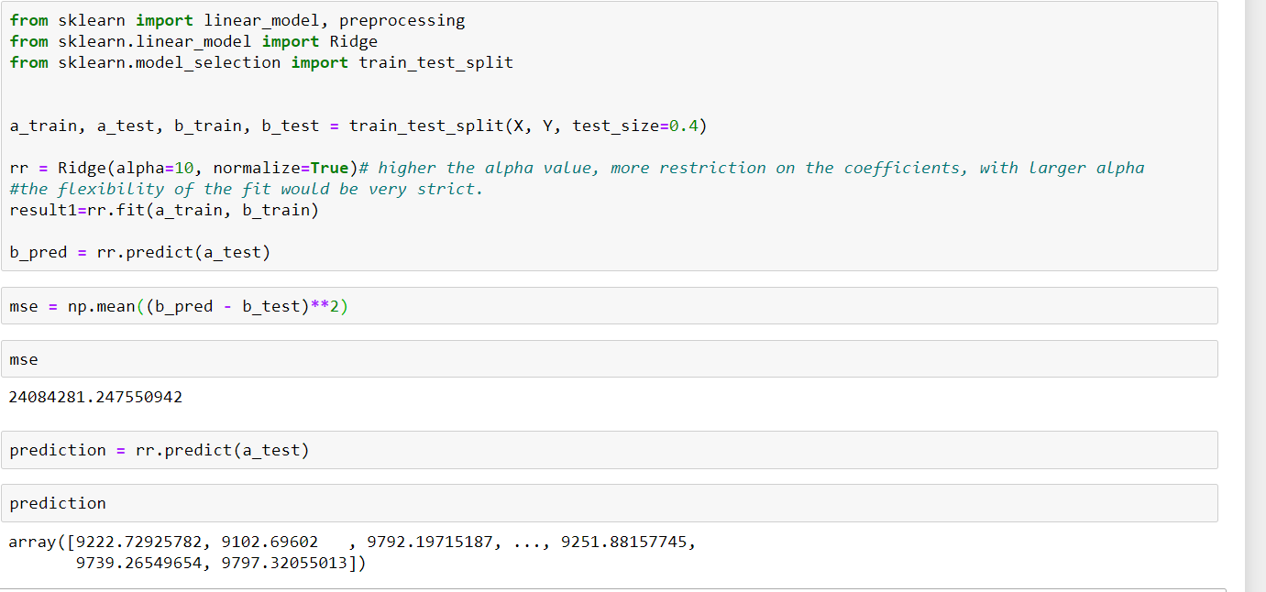

Slide 31
Conclusion
From the above, we can come to following conclusions :
- Regularisation has reduced the MSE
Hence we do Ridge Regression

Slide 32
Citation :
https://github.com/mathubhalan/Black-Friday-Sales
https://stackabuse.com/analysis-of-black-friday-shopping-trends-via-machine-learning/
https://medium.com/diogo-menezes-borges/project-3-analytics-vidhya-hackaton-black-friday-f6c6bf3da86f

Slide 33
Thank You!

